Slide 1
European Banks Core Financials
Exploratory Data Analysis

Slide 2
Summary
The EDA analysis showed that IT and ES banking systems are lagging behind AT, DE and NL in terms of asset quality and capitalization
Moreover, while the profitability converged to more similar levels in 2019, it was much more volatile in the previous years for IT and ES
The purpose of my project is to develop a machine learning model that could predict these variables for the respective countries
The EDA showed consistent performance for certain countries, giving the framework for the future predictions

Slide 3
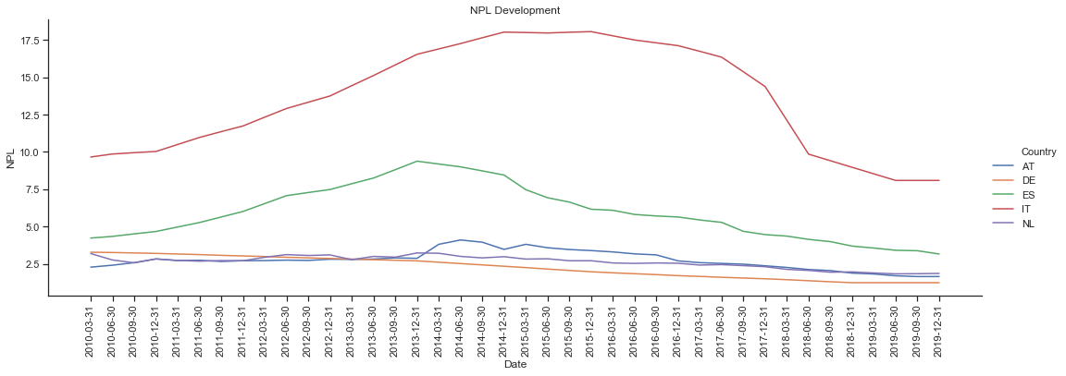
Asset quality
Non – performing loans

Slide 4
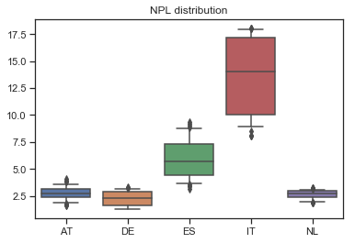
Asset quality
Non – performing loans
Differentiation between Western and Southern European countries
Higher volatility in the asset quality in IT and ES
Noticeable improvement in 2019 across all the banking systems

Slide 5
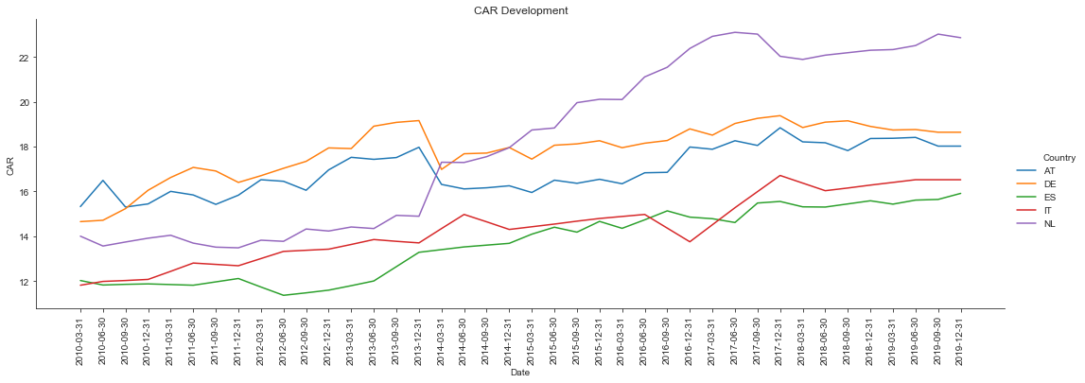
Capitalization
Capital adequacy ratio

Slide 6
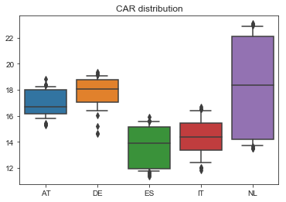
Capitalization
Capital adequacy ratio
Weaker performance by ES and IT, connected to the asset quality (above)
Interesting spread in the NL banks, needs more investigation

Slide 7
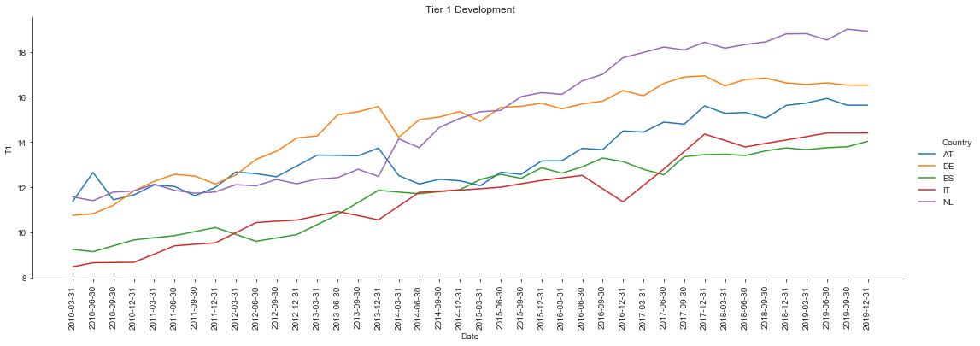
Capitalization
Tier 1 ratio

Slide 8
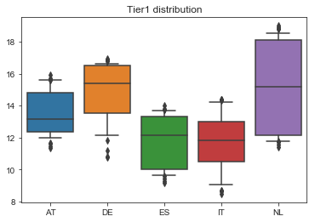
Capitalization
Tier 1 ratio
Similar developments as above

Slide 9
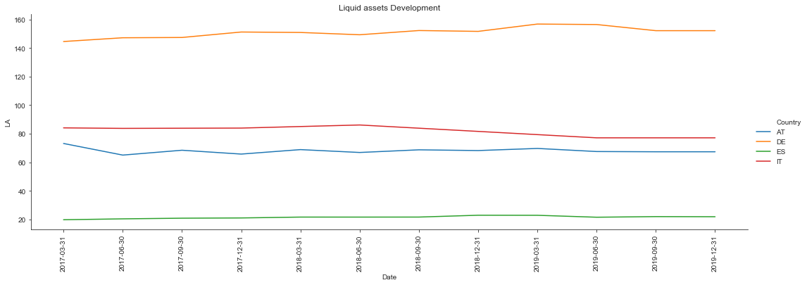
Liquidity
Liquid assets to ST funding

Slide 10
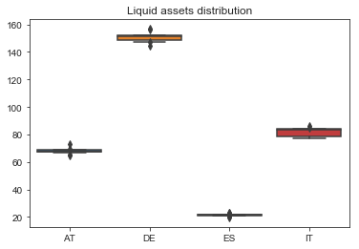
Liquidity
Liquid assets to ST funding
Almost no volatility across the countries and through the economic cycle
Missing data for NL
Surprised by the difference between IT and ES

Slide 11
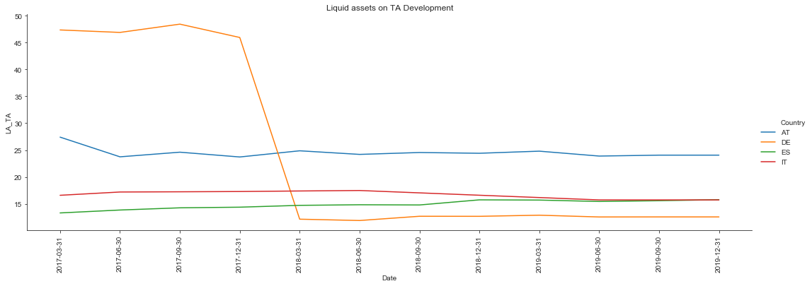
Liquidity
Liquid assets to Total assets

Slide 12
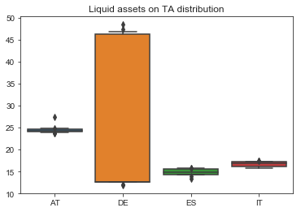
Liquidity
Liquid assets to Total assets
Big jump in the DE, maybe changed the criterias, otherwise can not explain
All other countries very stable development as expected

Slide 13
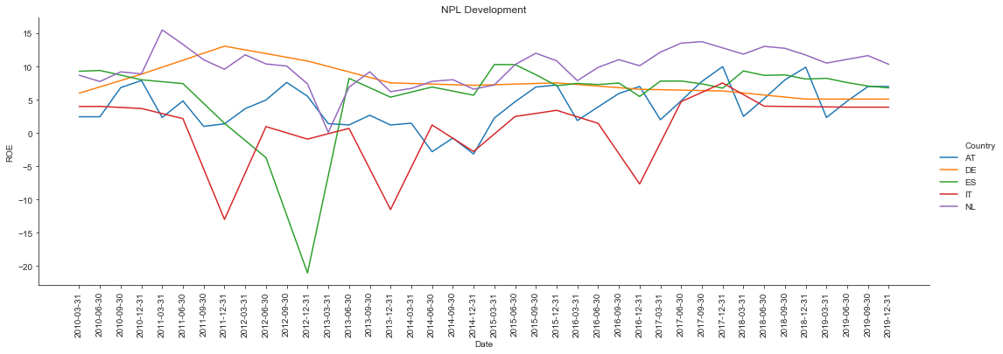
Profitability
RoE

Slide 14
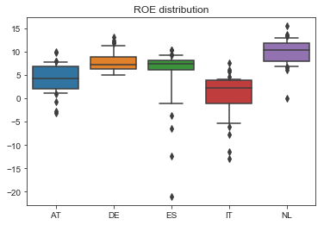
Profitability
RoE
Extreme observances in IT and ES due to loss making during the crises
Western countries as expected more steady performance

Slide 15
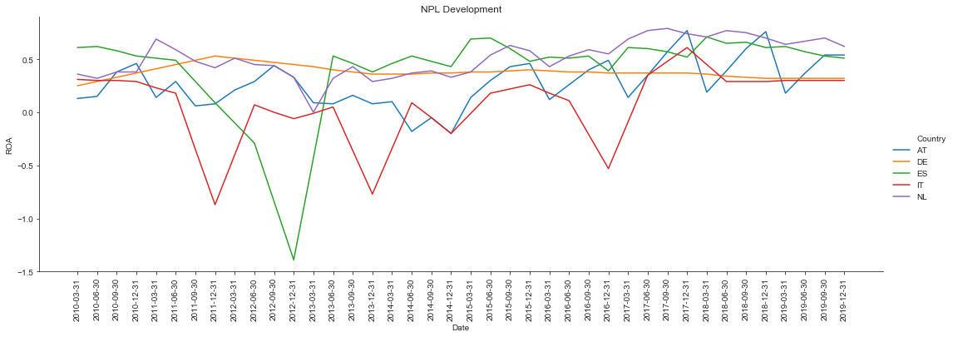
Profitability
RoA

Slide 16
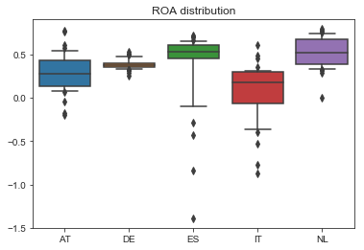
Profitability
RoA
Similar remarks as to the RoE
Convergence in profitability in the last years

Slide 17
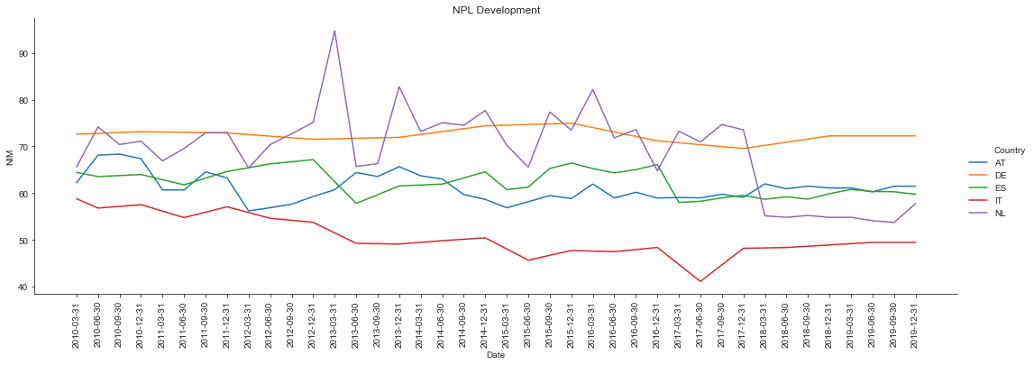
Profitability
Net interest margin

Slide 18
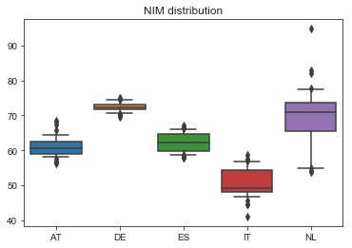
Profitability
Net interest margin
Lagging IT in reliance on the net interest income
Relatively low volatility except for NL, needs a proper investigation

